Slide 1
Project Mid Presentation CSE 465.1 Heart Disease Prediction Shakil Ahmed(1520789042)

Slide 2
Introduction
The goal of this project is to predict the presence of heart disease.
Dataset has a total of 303 rows.
There are total 13 features along with one target value which we will train the models to find.
The dataset is collected from https://www.kaggle.com/ronitf/heart-disease-uci

Slide 3
Task Done
Successfully read data from .csv file.
Reviewed all the data.
Checked max, mean, min,std.
Checked type of data.
Analysis the data by ploting graphs.
Correlation Matrix

Slide 4
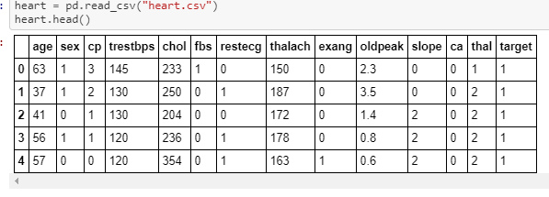
Reading the dataset

Slide 5
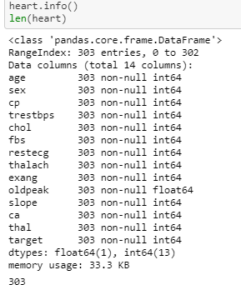
Information of dataset

Slide 6
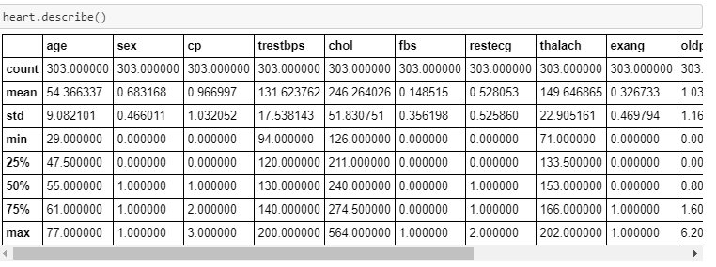
Description of dataset

Slide 7
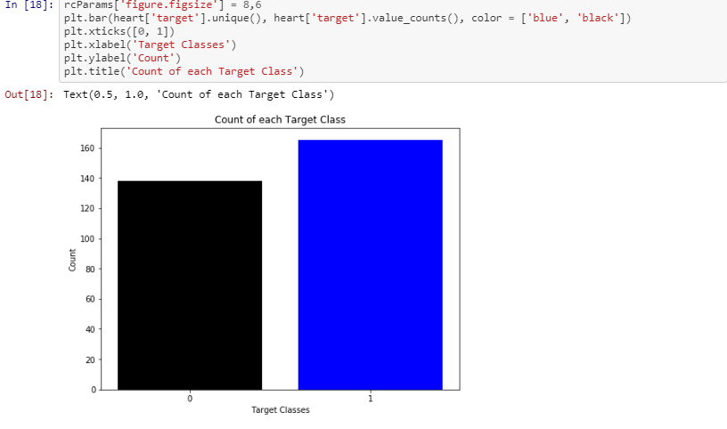
Ratio of how many people have heart disease or not

Slide 8
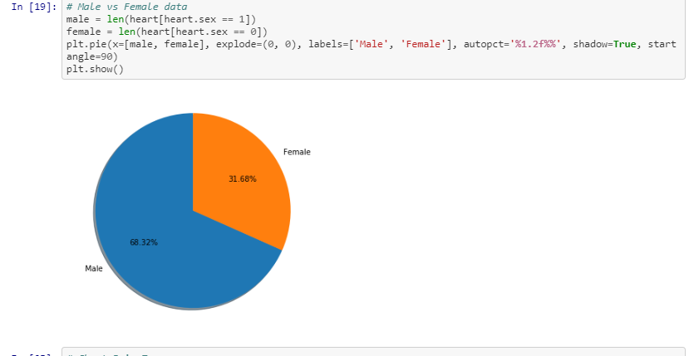
Male vs Female Data

Slide 9
Problems faced
Heard to evaluate the correlation matrix.
Difficult to understand the dataset.
Difficulty in pointing out the relations of the attributes with the target value.

Slide 10
Future Task
Accuracy Check
Find Best Classifier
Confusion Matrix , ROC and AUC curve
Splitting the dataset into training dataset and testing dataset.
Evaluation of the Trained model with the test dataset.
Apply Random Forest Algorithm , Support Vector Machine.
THANK YOU

